Slide 1
Craigslist Used Vehicle Analysis
Presented by Tushar Muley
March 5, 2022
Bellevue University DSC 680 | Professor B. Werner

Slide 2
Navigating the Used Car Market
Intro
Experience of selling a car
The never seen in history car market
Pandemic used car market by the numbers
Analyzing the used car market
Predicting used car prices
Conclusion

Slide 3
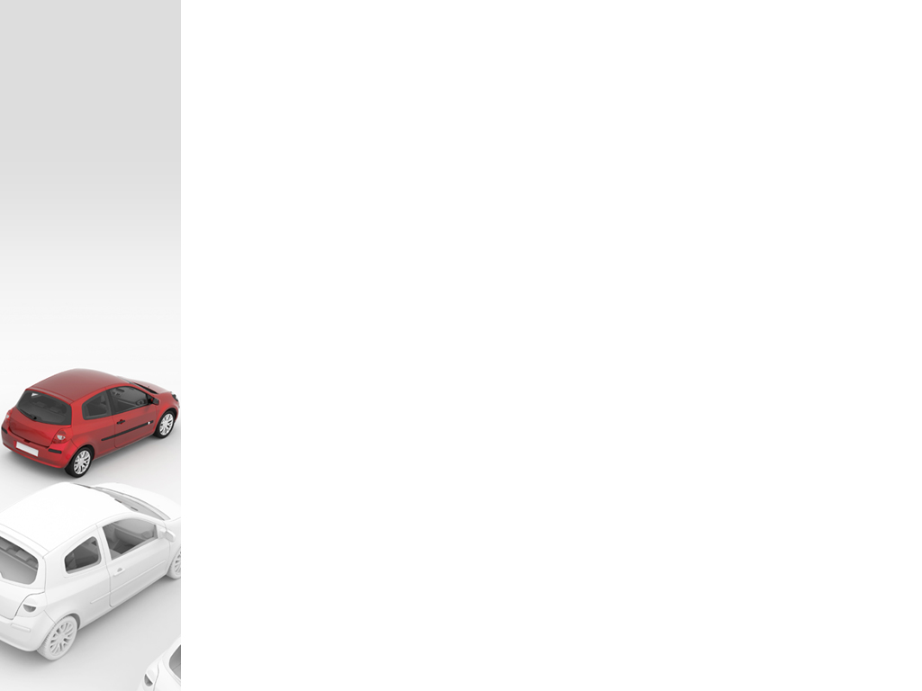





Experience of Selling a Car

Slide 4



Never seen in history car market
80%
Of new car buys paid over MSRP
$45,743
Average Price of new car
20.7%
Higher for salvage cars

Slide 5



Pandemic Used Car Market
$31,676
Average used car price in 2021
35%
Increase in price of used cars in 2021
39.3
Million used vehicles sold in 2021

Slide 6
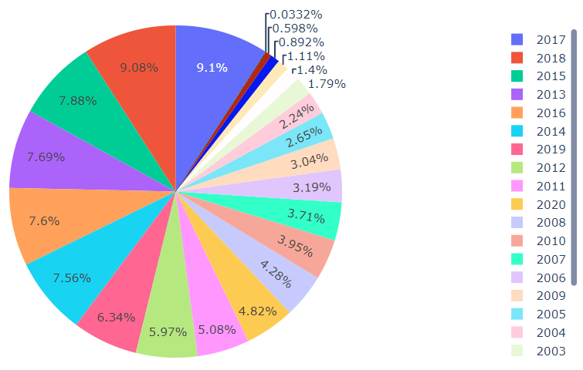
Analyzing the Used Car Market
Which model years are most frequently coming up for sale?
Used Car Sales by Model Year
3 to 8 year old cars are the most frequent models
2017 and 2018 are most frequent models years for sale

Slide 7
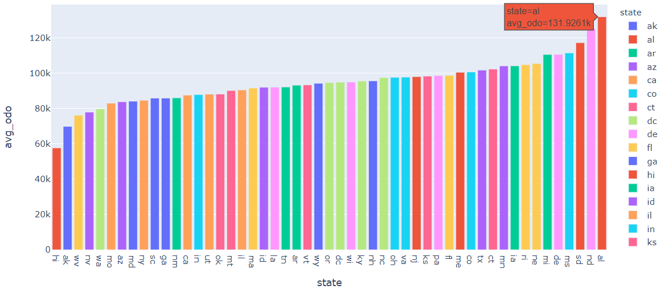
Analyzing the Used Car Market Cont…
What is the average odometer reading?
Average miles on Used Cars by State
Very state dependent
Alabama had the highest average mile cars
Hawaii had the lowest miles

Slide 8
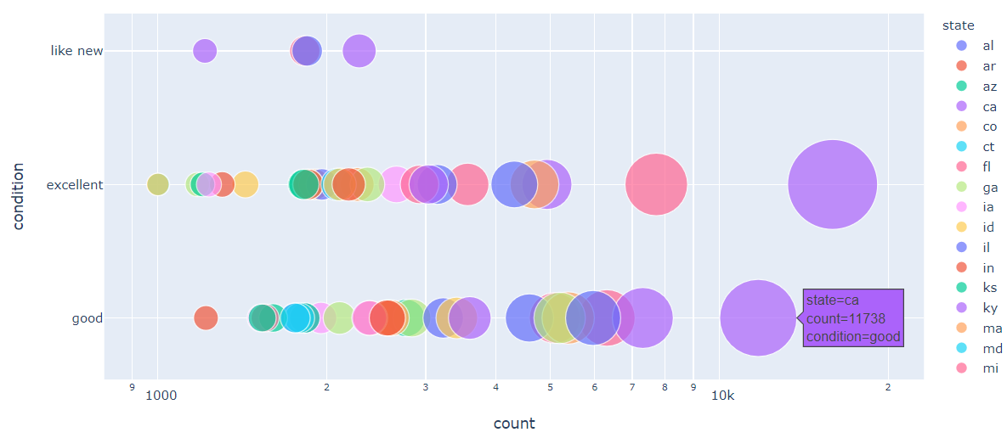
Analyzing the Used Car Market Cont…
What is the most common condition listed?
Listed Condition of Used Cars by State
Californian’s and New York's have the highest opinion on the condition of their cars.

Slide 9
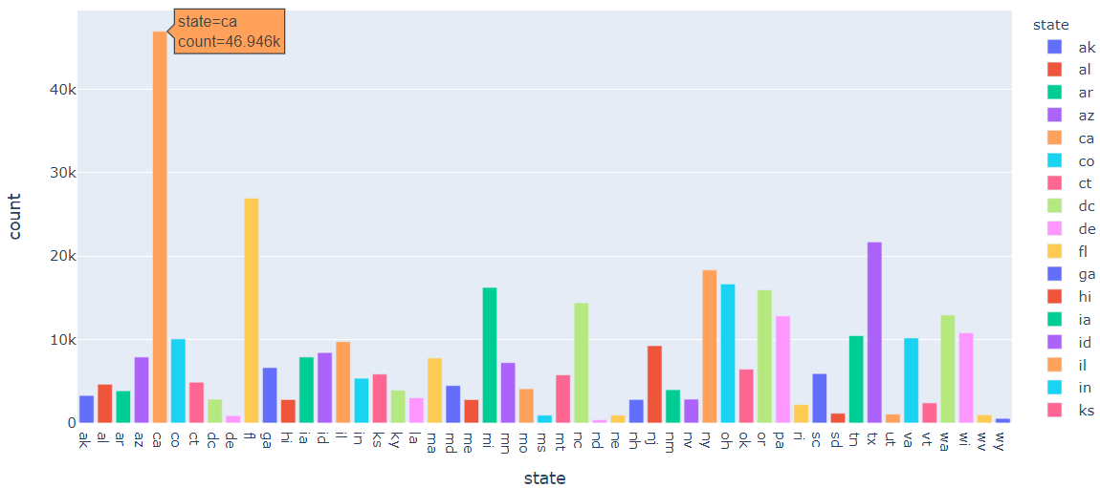
Analyzing the Used Car Market Cont…
What states are seeing the largest used car sales?
Used Car Sales by State
California sees the highest average prices for use vehicles
The state with the lowest average price is Wyoming 543 sales

Slide 10
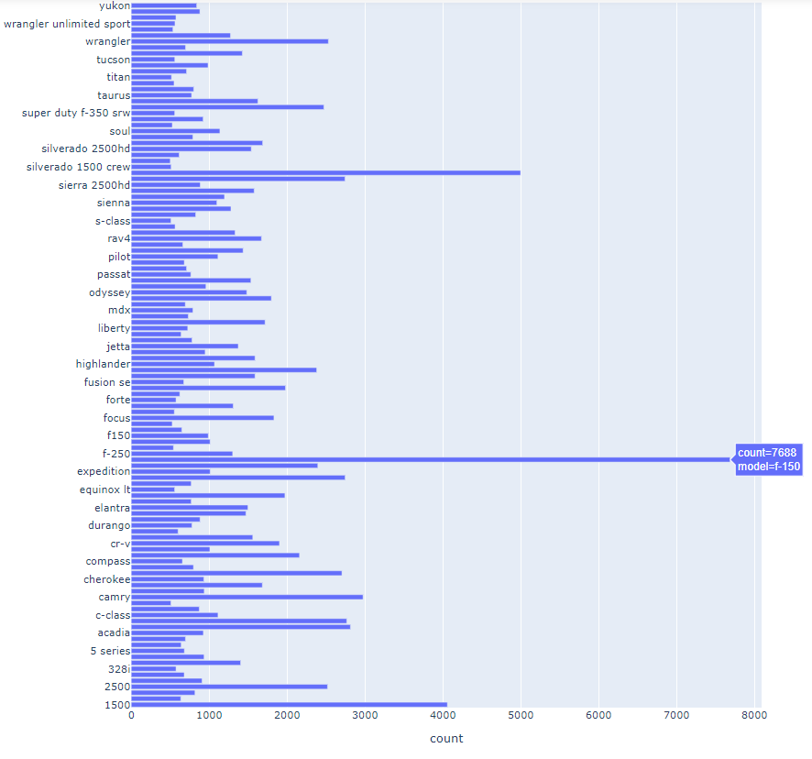
Analyzing the Used Car Market Cont…
Which make of car makes up the majority of vehicles listed?
Volume by Model
Ford’s F150 has the highest volume
Chevy Silverado claims second

Slide 11
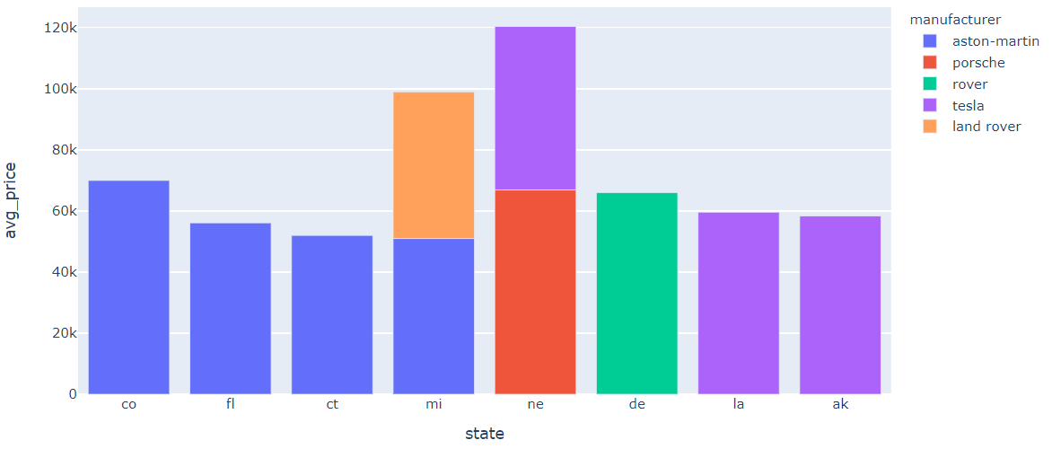
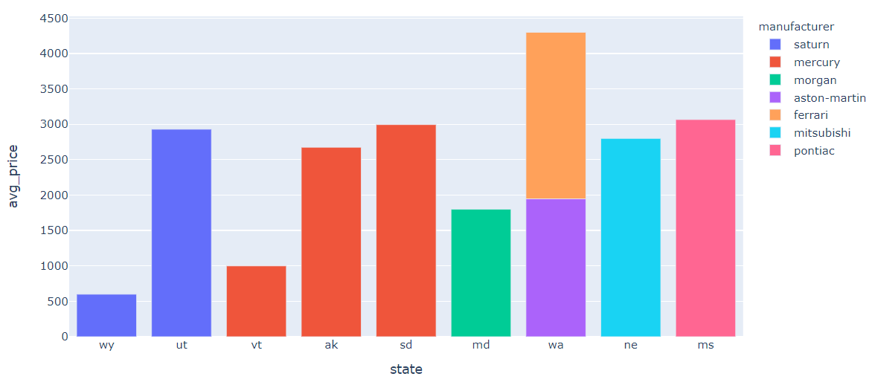
Analyzing the Used Car Market Cont…
Which manufactures are seeing highest average sale prices by state?
Top 10 Sale Prices by Manufacture and State
Bottom 10 Sale Prices by Manufacture and State

Slide 12
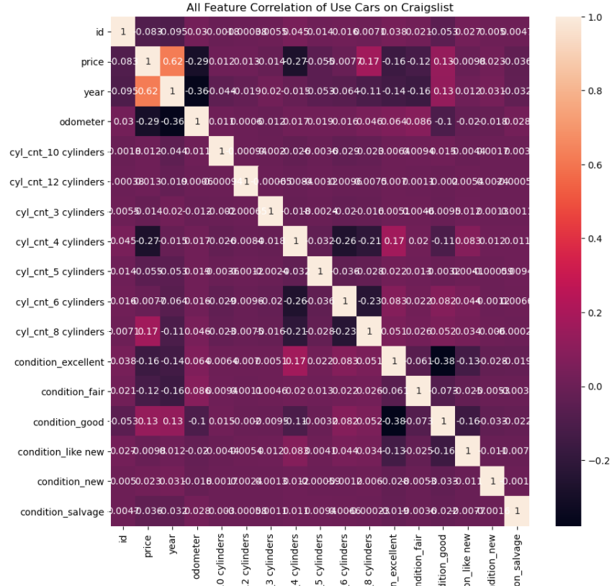
Predicting used car prices
Correlation Matrix of Feature in Predicting Used Car Prices
Feature Engineering
Additional 13 New Features

Slide 13
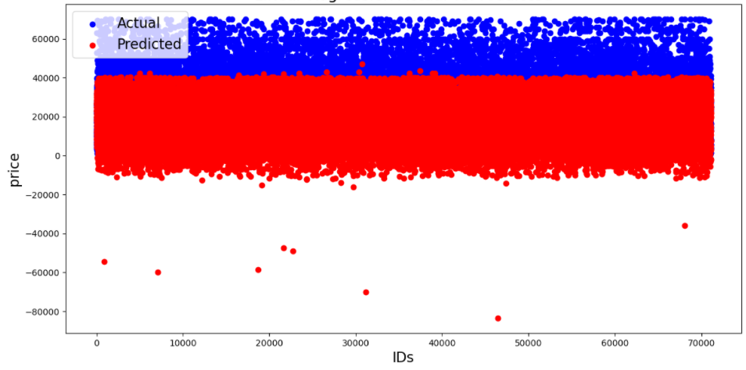
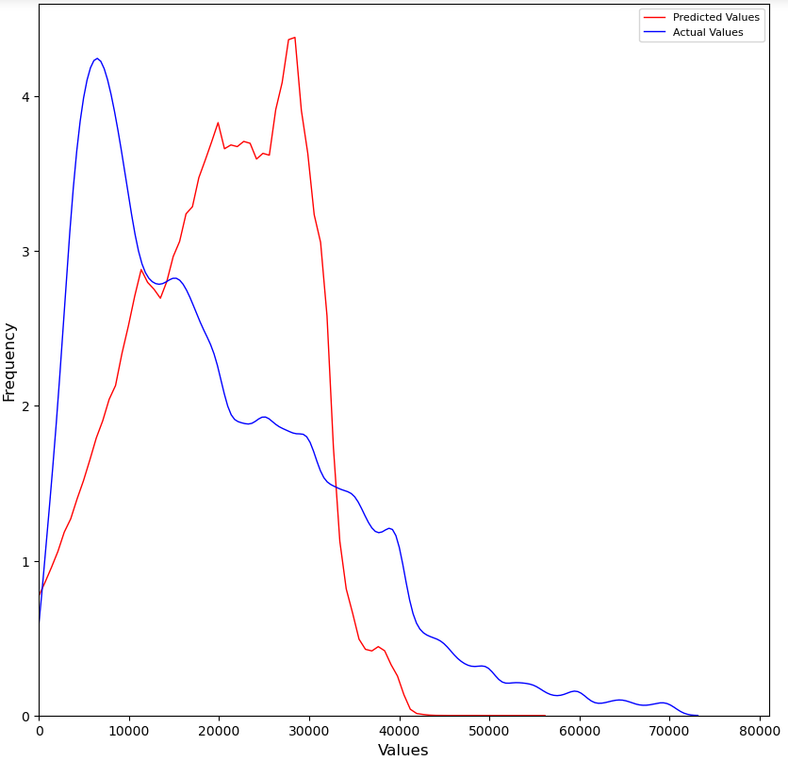
Predicting used car prices
Linear Regression and OLS Model
Linear Regression
R² = 0.5012
RMSE = 9505
OLS Model
R² = 0.5000
F-Statistic = 2.377x10⁴

Slide 14
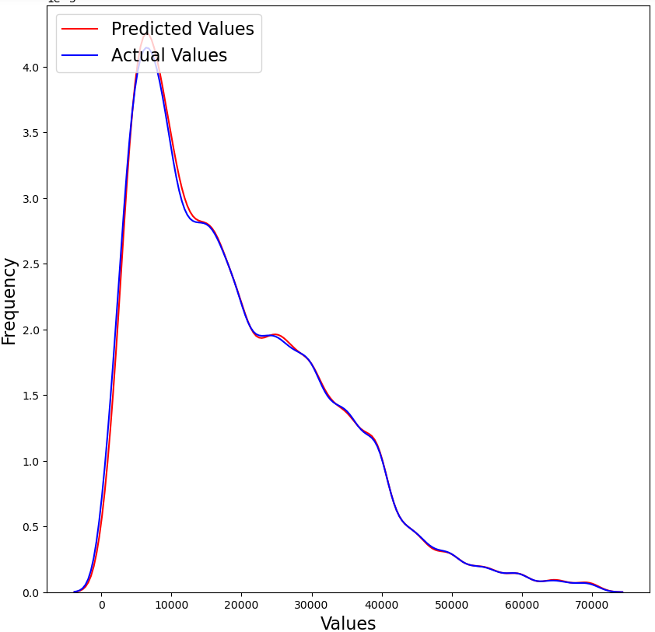
Predicting used car prices Cont…
Decision Tree Regressor Model
R² = 0.7216
RMSE = 7100

Slide 15
Conclusion
Decision Tree Model – 72% Accuracy
Future Plans to Improve the Analysis
Additional Features
Additional Data
Pricing by Vehicle Model
Different Model

Slide 16
Thank you

